Slide 1
DATA BASE MANAGEMENT SYSTEMS
III SEM AI&DS
BY:NARESH BABU.K
Associate Professor
AI&DS

Slide 2
Course Objectives:
Introduce database management systems and to give a good formal foundation
on the relational model of data and usage of Relational Algebra
Introduce the Relational model and the introduction of entities and attributes
Introduce the concepts of basic SQL as a universal Database language
Demonstrate the principles behind systematic database design approaches by
covering conceptual design, logical design through normalization
Provide an overview of physical design of a database system, by discussing
Database indexing techniques and storage techniques

Slide 3
Course Outcomes:At the end of the course, student will be able to
Understand the concepts of relational database and object-oriented database
(L2)
Apply Relational model and ER model for database design (L3)
Execute SQL commands to create, maintain and manipulate a relational
database (L3)
Interpret and apply schema refinement and normalization concepts for
database design (L3)
Implement indexing and transaction concepts for data base design (L3)

Slide 4
Text Books:
Database Management Systems, 3rd edition,Raghurama Krishnan, Johannes Gehrke, TMH (For Chapters 2, 3, 4)
Database System Concepts, 5th edition, Silberschatz, Korth, Sudarsan, TMH (For Chapter 1 and Chapter 5)
Reference Books:
Introduction to Database Systems, 8th edition, C J Date, Pearson.
Database Management System, 6th edition, Ramez Elmasri, Shamkant B. Navathe, Pearson
Database Principles Fundamentals of Design Implementation and Management, Corlos Coronel, Steven Morris, Peter Robb, Cengage Learning.
Web Resources:
https://nptel.ac.in/courses/106/105/106105175/
https://infyspringboard.onwingspan.com/web/en/app/toc/lex_auth_01275806667282022456_shared/overview

Slide 5
Unit – I Introduction:
Database system, Characteristics (Database Vs File System), Database Users,Advantages of Database systems, Database applications. Brief introduction of different Data Models; Concepts of Schema, Instance and data independence; Three tier schema architecture for data independence; Database system structure, environment.
Unit – II Relational Model:
Introduction to relational model, concepts of domain, attribute, tuple, relation,importance of null values, constraints (Domain, Key constraints, integrity constraints) and their importance. Entity Relationship Model: Introduction, Representation of entities, attributes, entity set,relationship, relationship set, constraints, sub classes, super class, inheritance, specialization, generalization using ER Diagrams.

Slide 6
Unit – III SQL:
Basic SQL querying (select and project) using where clause, arithmetic & logical operations,SQL functions(Date and Time, Numeric, String conversion).Creating tables with relationship, implementation of key and integrity constraints, nested queries, sub queries, grouping, aggregation,
ordering, implementation of different types of joins, view (updatable and non-updatable), relational set operations. SQL: Simple Database schema, data types, table definitions (create, alter), different DML
operations (insert, delete, update).Relational Algebra, Relational Calculus.
Unit – IV Schema Refinement (Normalization):
Purpose of Normalization or schema refinement, concept of
functional dependency, normal forms based on functional dependency Losslessjoin and dependency preserving decomposition, (1NF, 2NF and 3 NF), concept of surrogate key, Boyce-Codd normal form(BCNF), Fourth normal form(4NF), Fifth Normal Form(5NF).

Slide 7
Unit – V Transaction Concept:
Transaction State, ACID properties, Concurrent Executions in conflict resolution, Serializability, Recoverability, Implementation of Isolation, Testing for Serializability, lock based, time stamp based, optimistic, concurrency protocols, Deadlocks, Failure Classification, Storage, Recovery and Atomicity, Recovery algorithm.
Introduction to indexing: B+ trees, B+ trees operations.

Slide 8
UNIT-I
→Introduction to Database system
→Characteristics (Database Vs File System)
→Database Users
→Advantages of Database systems, Database applications.
→Brief introduction of different Data Models
→Concepts of Schema, Instance and data independence
→Three tier schema architecture for data independence
→Database system structure, environment

Slide 9
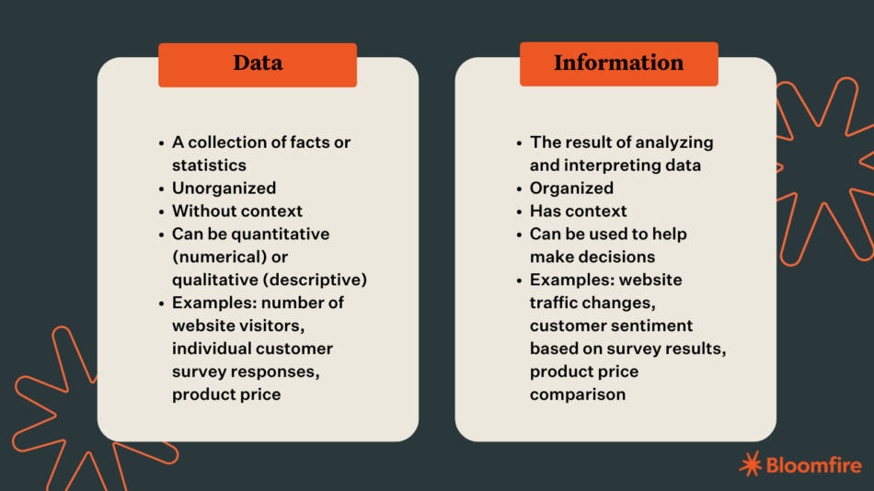
Introduction to Database system

Slide 10
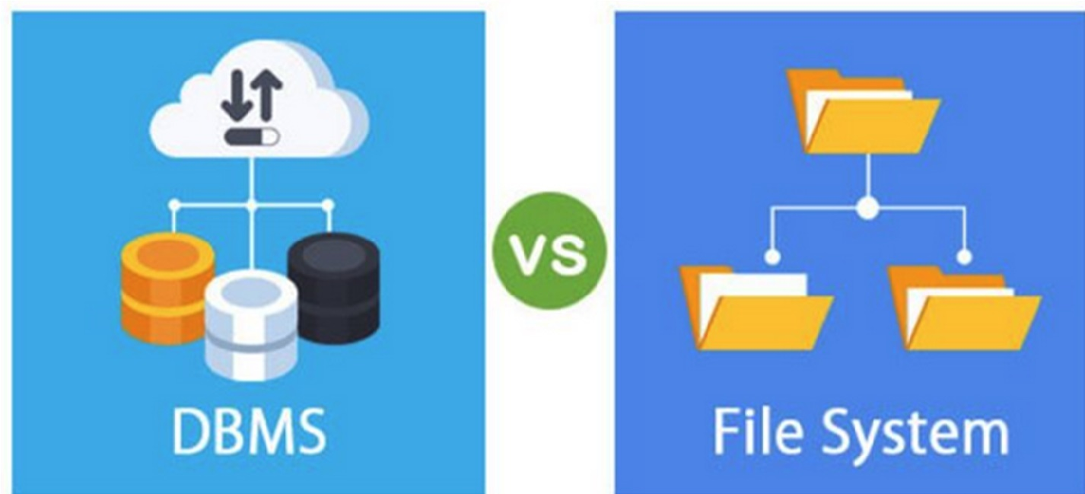
Characteristics (Database Vs File System)

Slide 11

File Systems
A file system is a method used by operating systems to
organize and store files on storage devices such as hard drives or solid-state drives.
It provides a hierarchical structure for storing and retrieving files, making it easier for users to navigate through their data.
A file system typically consists of directories (also known as folders) that contain files.
Required special programs to answer user questions.
Basic Operation: File Creation, File Reading and Writing, File Renaming, and Deletion.
Functionalities of a file system: File organization, File Access, File Storage.
Use cases: Personal Computing, Enterprise File Storage, Multimedia and Content Management

Slide 12

Identified Issues
Redundancy: Company address in all the employee records.
Data Integrity & Consistency: Duplication of employee IDs.
Data Retrieval: specific employee information ( Search, Open the file)
Data security and access control
SOLUTION

Slide 13
DBMS
A DBMS, or database management system, is a software application that provides an interface to manage databases.
It allows users to store, retrieve, update, and delete data in a structured and organized manner.
Data is organized in a structured manner using tables, rows, and columns.
Basic Operations: Data Definition, Manipulation and Querying.
Functionality: Data Integrity and Security, Data Relationships, Data Scalability and Performance.
Use cases: Business and Finance:, E-commerce and Retail, Healthcare and Research

Slide 14
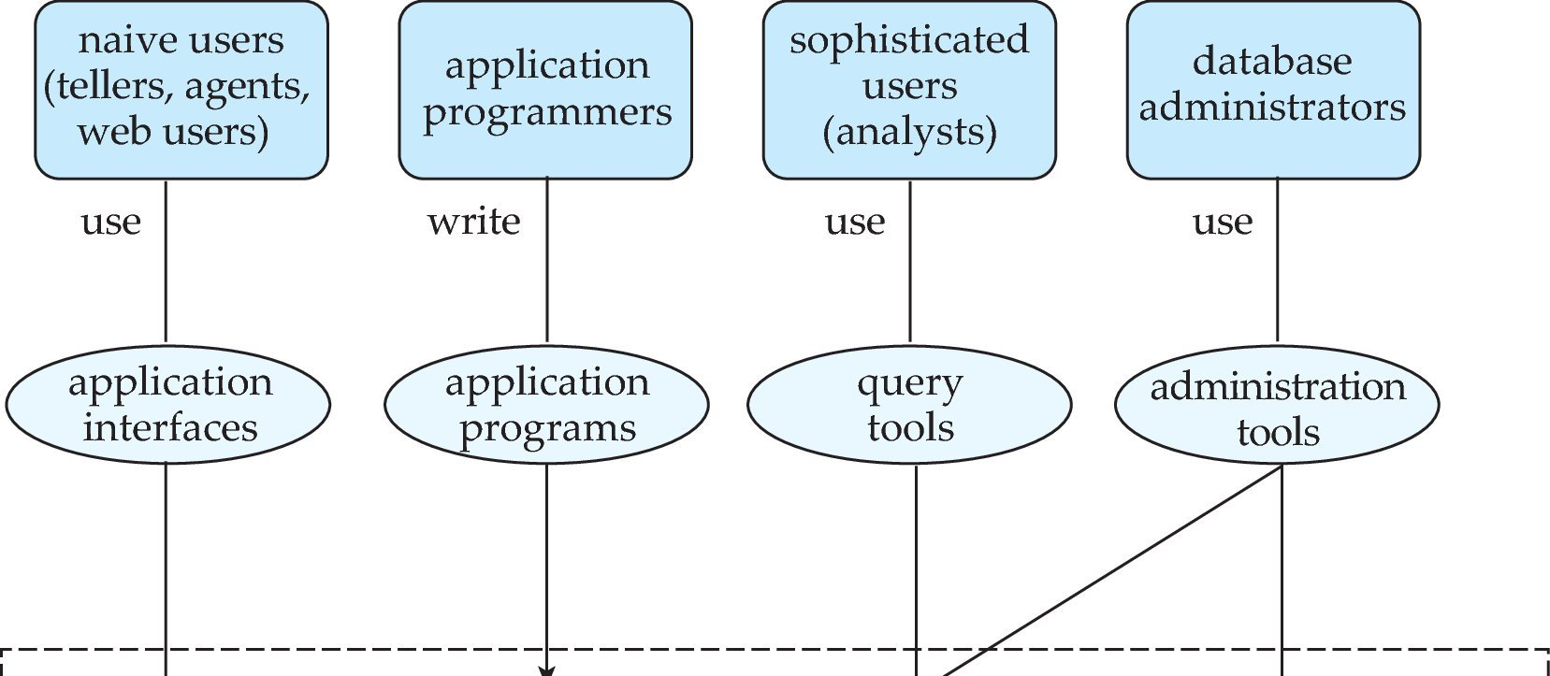
Database Users
Database

Slide 15
Database Users
Users are differentiated by the way they expect to interact with the system
Application programmers – interact with system through DML calls
Sophisticated users – form requests in a database query language
Specialized users – write specialized database applications that do not fit into the traditional data processing framework
Naïve users – invoke one of the permanent application programs that have been written previously
E.g. people accessing database over the web, bank tellers, clerical staff

Slide 16
Database Administrators (DBA):
The DBA is responsible
-authorizing access
-coordinating and monitoring
-acquiring software and hardware resources as needed
-accountable(security breaches and poor system response time.).
Database Designers:
identifying the data to be stored in the data-base and appropriate structures

Slide 17
Advantages of DBMS
Data Independence
Data Abstraction
Efficient Data Access
Data Integrity and Security
Data Administration
Concurrent Access and Crash Recovery
Reduced Application Development Time

Slide 18
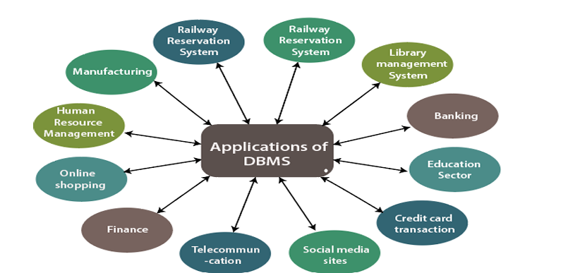
Database applications

Slide 19
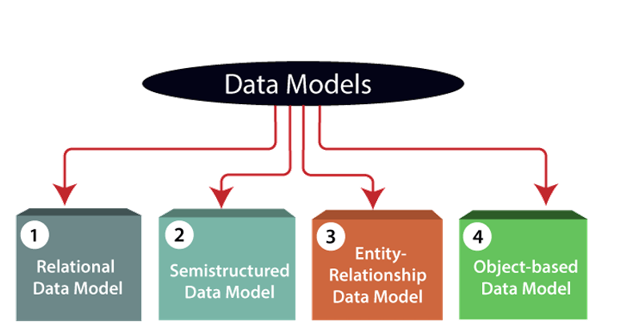
Different Data Models
Relational model
Semi structured Data model
Entity-relationship model
Object-oriented database model
Network model
Hierarchical database model

Slide 20
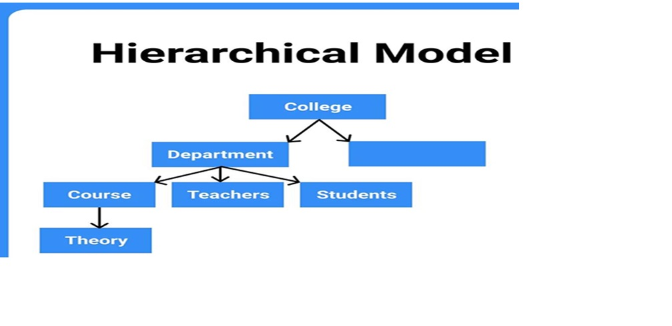
Tree based data structure format. there is a single root node and other data is linked to the same and expands like a tree.
1. A child node data may only have a single parent node
2. For any parent node one to many relationship must be maintained.

Slide 21
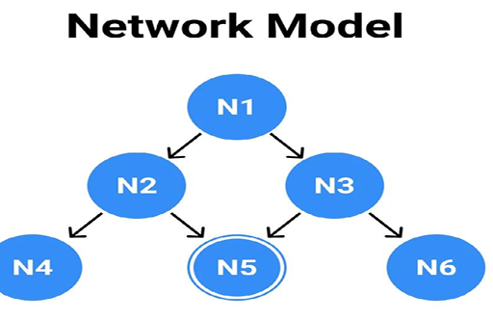
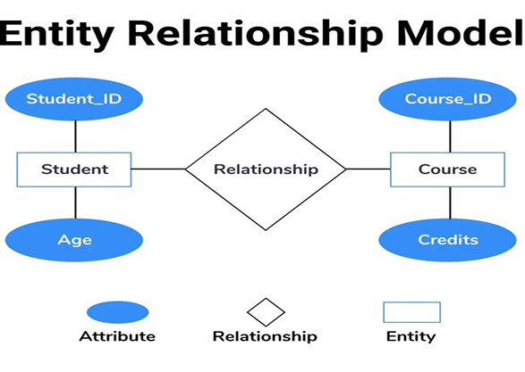
A child node may have more than one parent
There can be many to many relationships between data.
This is modeled about break and related model, i.e. we break data into different components based on characteristics, in terms of entity and attributes.

Slide 22
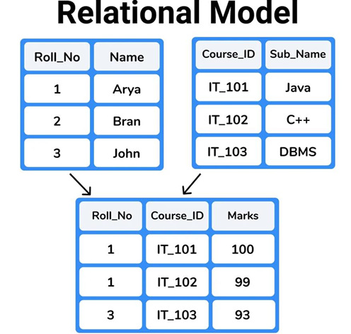
Relational model
This is the most used model and even with DBMS that we will studying in future posts it will be based upon the same
This works around
Rows
Entities
Tuples
Columns
Table

Slide 23
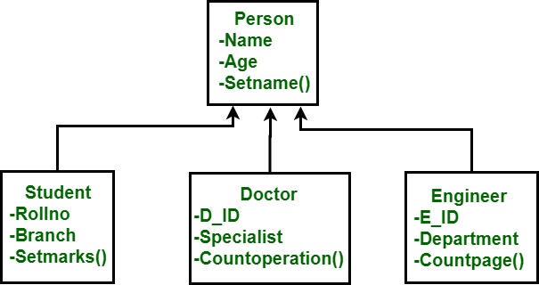
Object-oriented database model

Slide 24
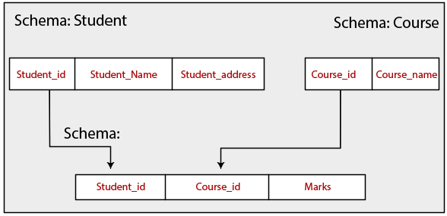
Schema, Instance and Indepandance
A very important advantage of using a DBMS is that it offers data independence. That is, application programs are insulated from changes in the way the data is structured and stored. Data independence is achieved through use of the three levels of data abstraction; in particular, the conceptual schema and the external schema provide distinct benefits in this area.

Slide 25
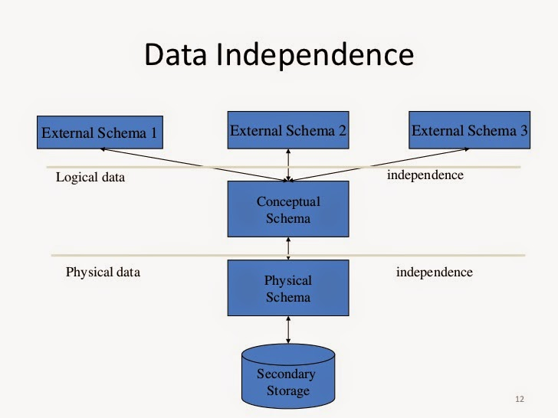
Three tier schema architecture for data independence

Slide 26
Database system structure
Centralized
Client-server
Parallel (multi-processor)
Distributed

Slide 27
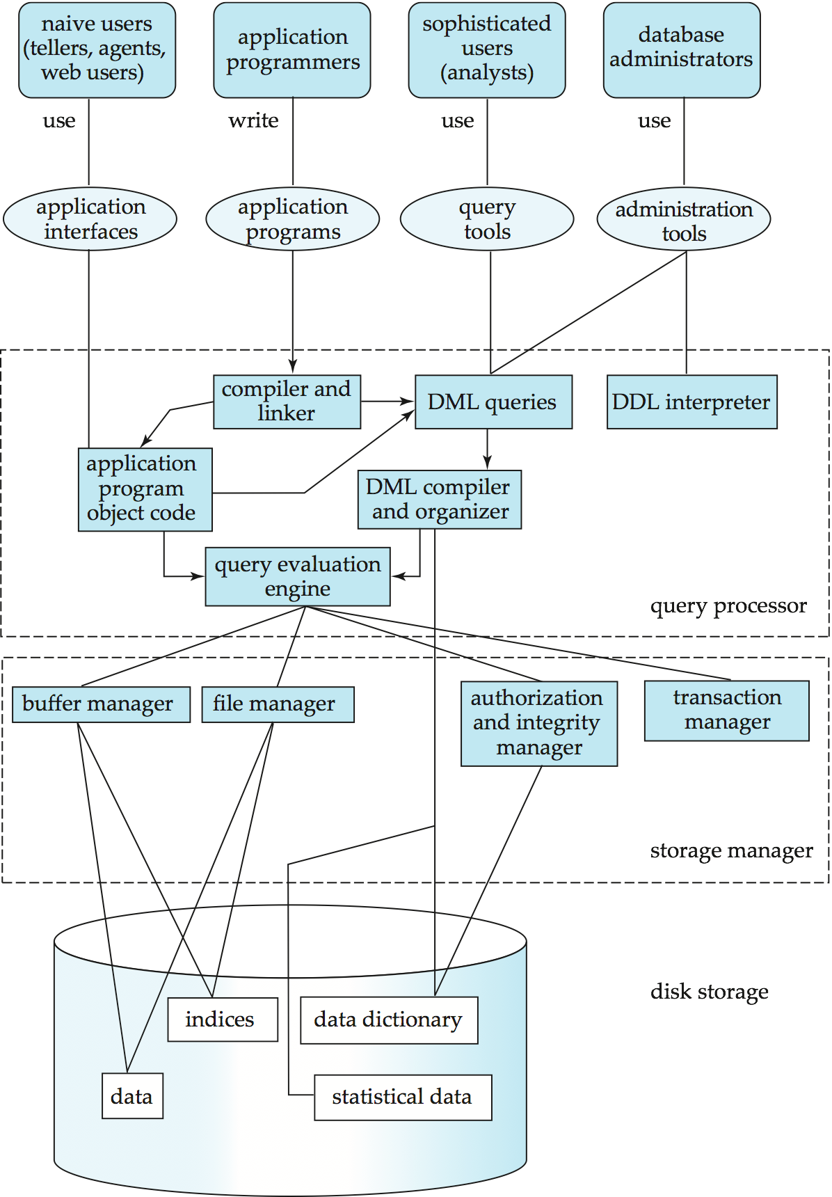
Centralized

Slide 28
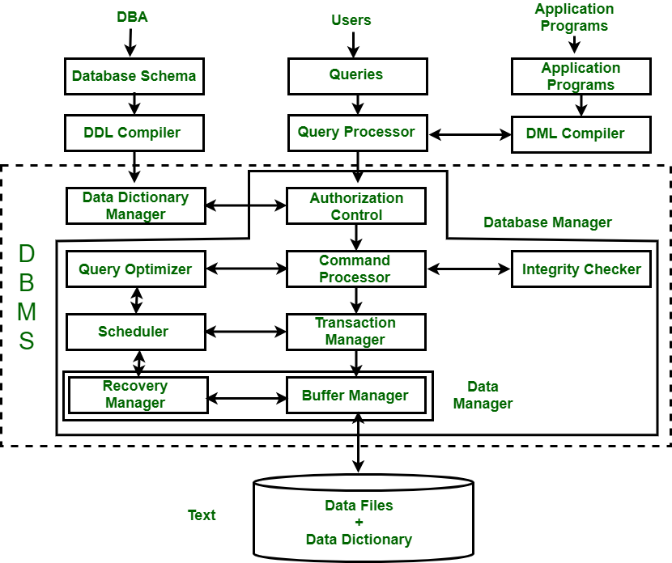

Slide 29
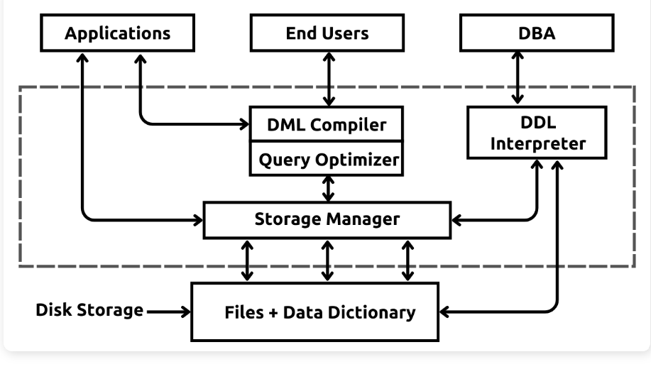

Slide 30
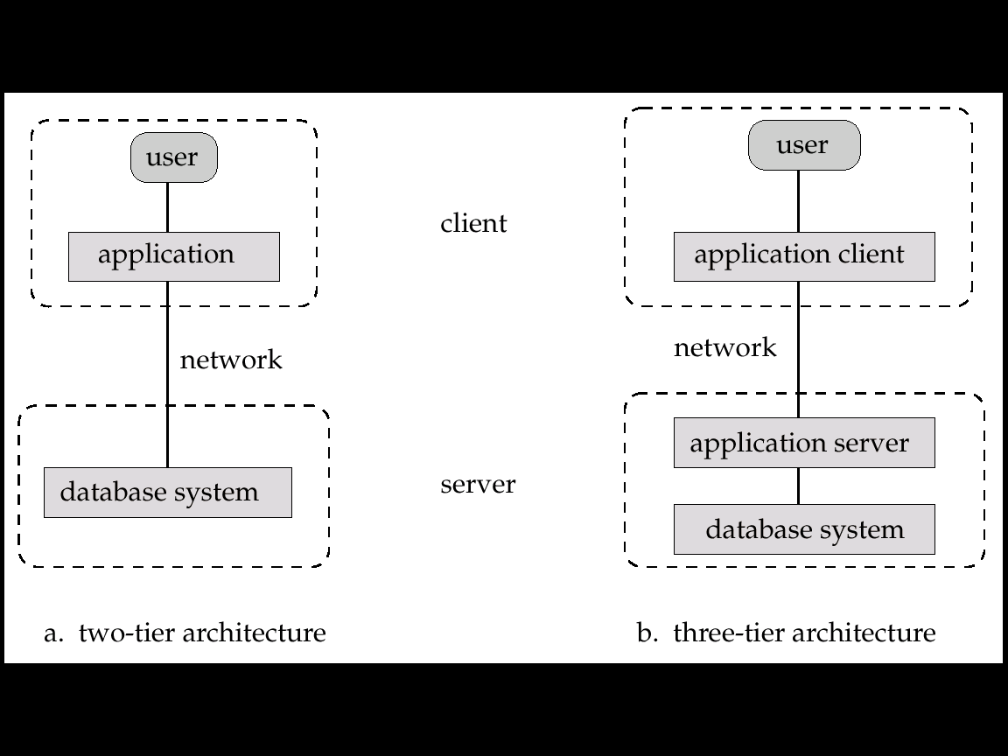
Client-server
Two-tier architecture: E.g. client programs using ODBC/JDBC to communicate with a database
Three-tier architecture: E.g. web-based applications, and applications built using “middleware”

Slide 31
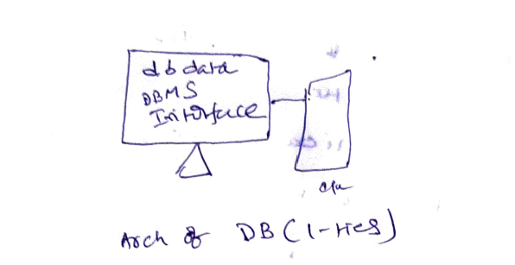

Slide 32
https://www.mentimeter.com/
Creation, altering and droping of tables and inserting rows into a table
(use constraints while creating tables) examples using SELECT command.

Slide 33
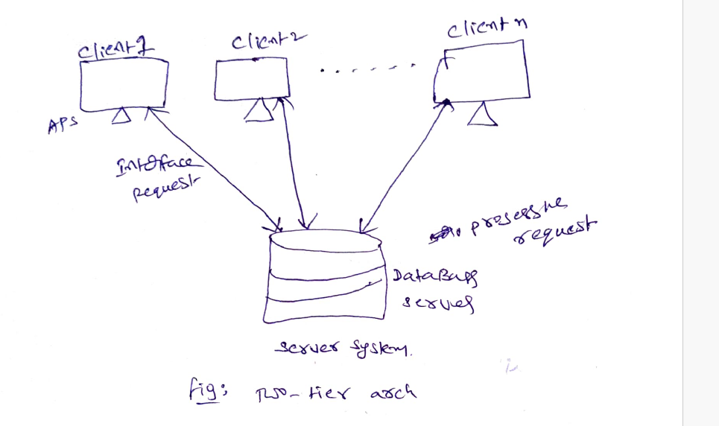

Slide 34
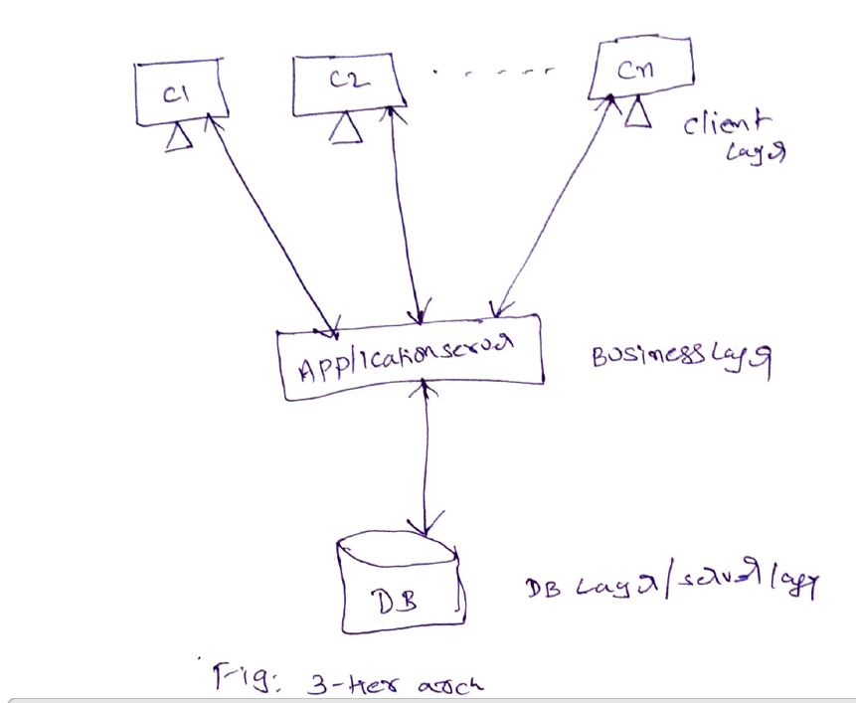

Slide 35
UNIT II:
PART-I: Relational Model
PART-II: Entity Relationship Model
PART-I: Relational Model
Introduction to relational model
2. Concepts of domain attribute tupple relation
3. Importance of null values
4. Constraints:
→domain constraints
→key constraints
→integrity constraints and their importance.

Slide 36
PART-II: Entity Relationship Model
Introduction
Representation of Entities Attributes Entity set Relationship Relation ship Set
3. Constraints on ER Model
Sub classes
Super classes
Inheritance
4. Specialization, generalization using
ER Diagrams.

Slide 37
RELATIONAL MODEL
→It is the most widely used model
→In this model the data is organized in the form of table.
→All the information is stored in the form of rows and columns.
→The basic structure of a relational model is a table.
→Tables are also called relations in the relational model.

Slide 38
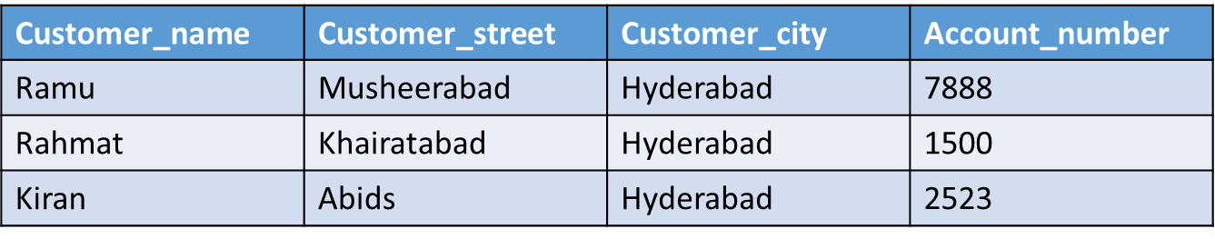

Slide 39
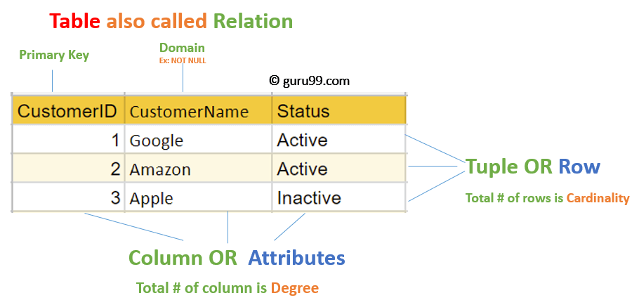

Slide 40
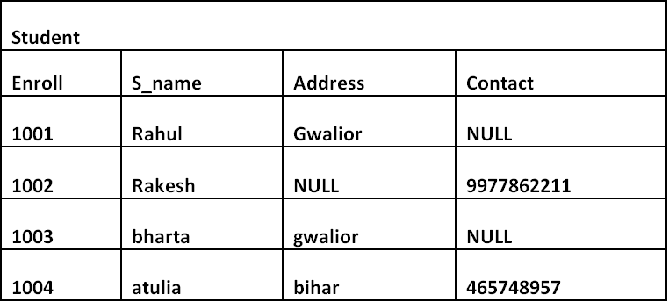
null values

Slide 41
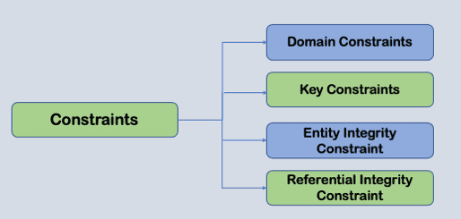
Constraints

Slide 42
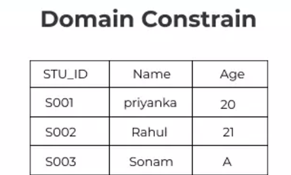

Slide 43
1. Domain Constraint : Specifies the type and range of values allowed.
Ex: Age INT CHECK (Age >= 18)
2. Key Constraint: Ensures that a key value is unique.
Ex: Student_ID INT PRIMARY KEY
3. Entity Integrity Constraint : The Primary Key cannot be NULL.
Ex:Student_ID INT PRIMARY KEY
Student_ID Name
101 Ravi
102 Sita
NULL Raju ❌ Not allowed
4. Referential Integrity Constraint : A Foreign Key value must match an
existing Primary Key value in another table. Ex: FOREIGN KEY (Dept_ID) REFERENCES Department(Dept_ID)

Slide 44
In simple words: Constraints = Rules on data
Domain → What values are allowed?
Key → Is the value unique?
Entity Integrity → Primary key cannot be NULL.
Referential Integrity → Foreign key must refer to a valid record.
Ex: CREATE TABLE Student (Student_ID INT PRIMARY KEY,Name VARCHAR(50),Age INT CHECK (Age >= 18));
Ex: CREATE TABLE Student (Student_ID INT PRIMARY KEY,Name VARCHAR(50),City VARCHAR(50) DEFAULT 'Hyderabad’);

Slide 45
ADDING CONSTRAINTS USING ALTER:
Add NOT NULL
Add DEFAULT
Add UNIQUE Constraint
Add PRIMARY KEY
Add CHECK Constraint
Add FOREIGN KEY
Genaral Syntax:
ALTER TABLE <tn> ADD CONSTRAINT <cnst name> cnstype(col name);
In Oracle, NOT NULL and DEFAULT commonly uses MODIFY

Slide 46
ALTER TABLE <tn> ADD CONSTRAINT <cnstname> cnsttype (colname);
ALTER TABLE student5 ADD CONSTRAINT chkage CHECK (Age>=18);
ALTER TABLE student5 ADD CONSTRAINT pksid primary key (sid);
ALTER TABLE student5 ADD CONSTRAINT unk unique(name);
ALTER TABLE Student5 MODIFY Age DEFAULT 18;
ALTER TABLE Student5 MODIFY Age not null;

Slide 47
REMOVING CONSTRAINTS USING ALTER:
General syn for pk,check,unique:
ALTER TABLE <tn> DROP CONSTRAINT <cnst name>;
ALTER TABLE student5 DROP CONSTRAINT chkage;
ALTER TABLE student5 DROP CONSTRAINT pksid;
ALTER TABLE student5 DROP CONSTRAINT unk;
General syn for not null and default:
ALTER TABLE <tn> MODIFY <colname> null;
ALTER TABLE Student5 MODIFY Age null;
ALTER TABLE Student5 MODIFY Age null;

Slide 48
alter table <tn> rename column oldname to newname;
alter table <tn> modify colname newdt;
alter table <tn> rename to newtn;

Slide 49
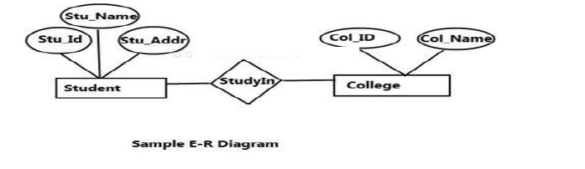

Slide 50
Rectangle: Represents Entity sets.
Ellipses: Attributes
Diamonds: Relationship
Lines: They link attributes to Entity Sets and Entity sets to Relationship Set
Double Ellipses: Multivalued Attributes
Dashed Ellipses: Derived Attributes
Double Rectangles: Weak Entity Sets
Double Lines: Total participation of an entity in a relationship set

Slide 51
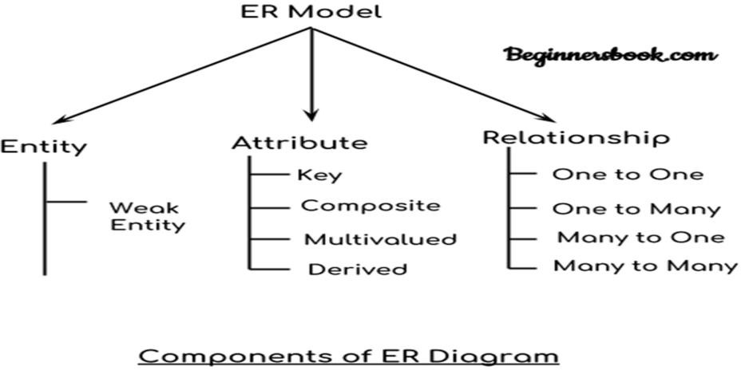

Slide 52
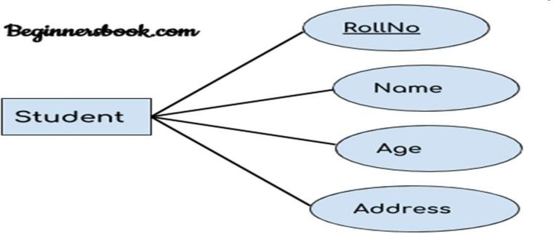
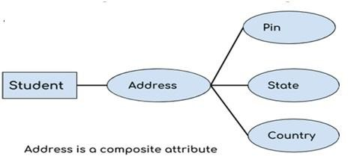
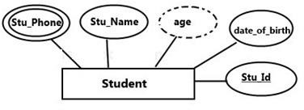

Slide 53
Constraints on ER Model:
Constraints in an Entity-Relationship (ER) Model define the rules that maintain the accuracy and consistency of data in a database.
Types of Constraints:
Cardinality Constraint
Participation Constraint

Slide 54
Cardinality Constraint
Specifies the number of entities that can participate in a relationship.
Types:
One-to-One (1:1)
One-to-Many (1:N)
Many-to-One (N:1)
Many-to-Many (M:N)
Participation Constraint
Specifies whether the participation of an entity in a relationship is mandatory or optional.
Types:
Total Participation: Every entity must participate.
Partial Participation: Participation is optional.

Slide 55

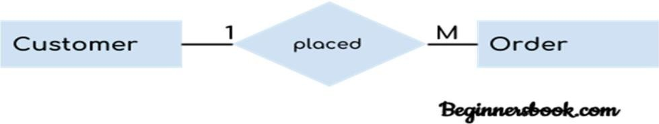

Slide 56
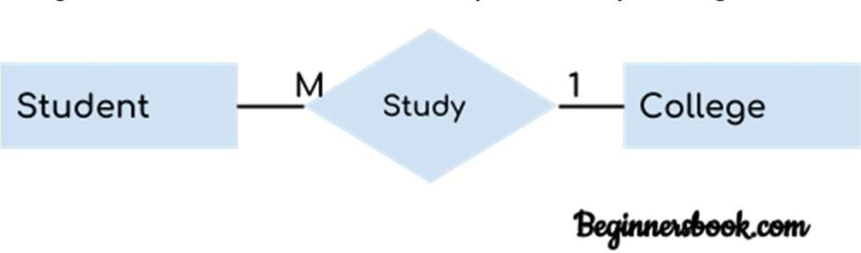
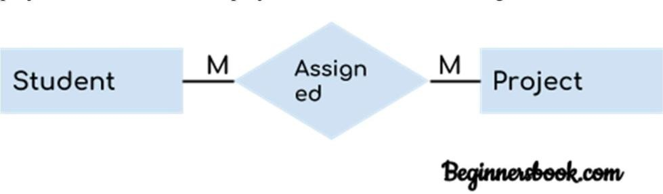

Slide 57

Steps to Create an ERD (E-R Digram)

Slide 58
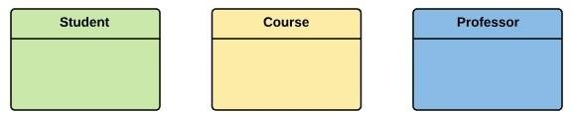
Let's study them with an example:
In a university, a Student enrolls in Courses. A student must be assigned to at least one or more Courses. Each course is taught by a single Professor. To maintain instruction quality, a Professor can deliver only one course
Step 1) Entity Identification
We have three entities
Student
Course
Professor

Slide 59
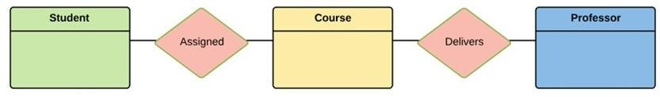
Step 2) Relationship Identification
We have the following two relationships
The student is assigned a course
Professor delivers a course

Slide 60
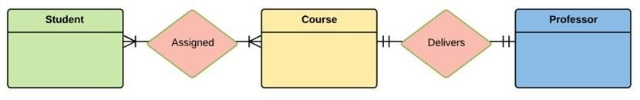
Step 3) Cardinality Identification
For them problem statement we know that,
A student can be assigned multiple courses
A Professor can deliver only one course

Slide 61
Step 4) Identify Attributes
Entity | Primary key | attribute2 | attribute3 | attribute4 | attribute5
Student | sid | sname | dob | age | phno
course | cid | cname | fee | duration
professor | pid | pname | doj | address | exp

Slide 62
Problem Draw an ER model of the Banking database application considering the following constraints −
A bank has many entities.
Each customer has multiple accounts.
Multiple customers belong to a single branch.
Single customer can borrow multiple loans.
A branch has multiple employees.

Slide 63
Step 1 − Identify the entities
As per the given constraints the entity sets are as follows −
Customer
Account
Branch
Loan
Employee

Slide 64
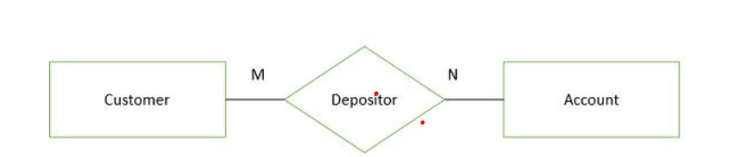
Step 2 3
Identify the relationships and type b/w entity sets
One customer is enrolled by multiple accounts and one account for multiple customers. Hence, the relationship is many to many.

Slide 65
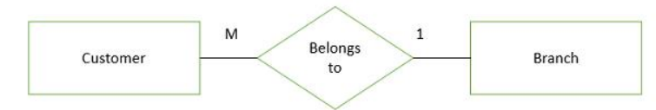
Many customers belong to one branch but one branch belongs to many customers. Hence, the relationship between customer and branch is many to one.

Slide 66
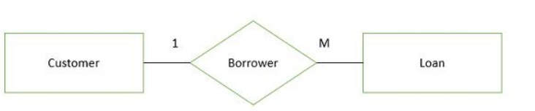
One customer can borrow multiple loans in the same way multiple loans can borrow a single customer, hence the relationship between customer and loan is one to many.

Slide 67
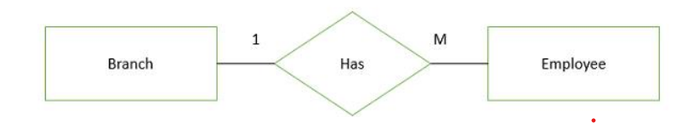
One branch has many employees and in the same way the number of employees works in a single branch.

Slide 68
Step-4
Attributes identification

Slide 69
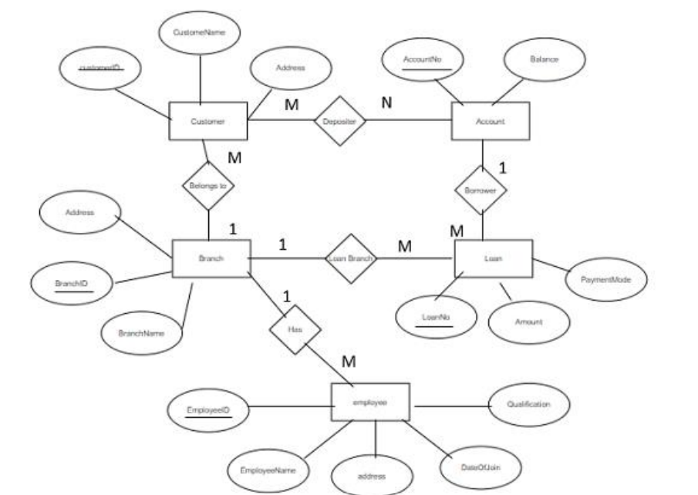

Slide 70
Design a database for an airline. The database must keep track of customers and their reservations, flights and their status, seat assignments on individual flights, and the schedule and routing of future flights. Your design should include an E-R diagram, a set of relational schemas, and a list of constraints, including primary-key and foreign-key constraints.
Notes:
++

Slide 71
CUSTOMERS
2. RESERVATION
3. SEAT ARRANGEMENT
4. FLIGHTS
5. SCHEDULE

Slide 72
1. CUSTOMER RESERVES RESERVATION 1-M
2. RESERVATION HAVING FLIGHTS M-1
3.FLIGHTS CONTAINS SEATS 1-M
4. FLIGHTS HAVE SCHEDULE 1-1

Slide 73
CUSTOMERS : CID (PK),CNAME,ADD
2. RESERVATION : RID (PK) ,CID (FK), FID (FK), DOR (Date of Reservation)
3. Seats : SeatNo ,RID (FK), FID (FK)
4.FLIGHTS : FID (PK)s,NAME, ARRT (Arrival Time) , DETIME (Departure Time)
5. SCHEDULE : FID (PK,FK) ,INT (In Time) ,OUTT (Out Time)

Slide 74
CUSTOMER Table
FLIGHTS Table
RESERVATION Table
SEAT_ARRANGEMENT Table
SCHEDULE Table

Slide 75
CREATE TABLE CUSTOMER(CID INT PRIMARY KEY,CNAME VARCHAR(50), ADDR VARCHAR(100));
CREATE TABLE FLIGHTS( FID INT PRIMARY KEY,FNAME VARCHAR(50),
ARRTTIME date, DETIMETIME date);
CREATE TABLE RESERVATION(RID INT PRIMARY KEY,CID INT,FID INT, DOR DATE, FOREIGN KEY (CID) REFERENCES CUSTOMER, FOREIGN KEY (FID) REFERENCES FLIGHTS);
CREATE TABLE SEAT_ARRANGEMENT(SeatNo VARCHAR(10),RID INT, FID INT,
PRIMARY KEY (SeatNo, FID),FOREIGN KEY (RID) REFERENCES RESERVATION,FOREIGN KEY (FID) REFERENCES FLIGHTS);
CREATE TABLE SCHEDULE (FID INT PRIMARY KEY, INTIME, OUTTIME,
FOREIGN KEY (FID) REFERENCES FLIGHTS);

Slide 76
Subclasses :
A subclass is a class derived from the superclass. It inherits the properties of the superclass and also contains its own attributes.
Superclasses
A superclass is the class from which many subclasses can be created. The subclasses inherit the characteristics of a superclass. The superclass is also known as the parent class or base class.
Inheritance
Inheritance is basically the process of basing a class on another class i.e to build a class on a existing class. The new class contains all the features and functionalities of the old class in addition to its own.

Slide 77
Specialization:
Specialization is the process of dividing a superclass into one or more subclasses based on distinguishing characteristics.
Generalization:
Generalization is the process of combining two or more similar entities into a single superclass based on their common features.

Slide 78
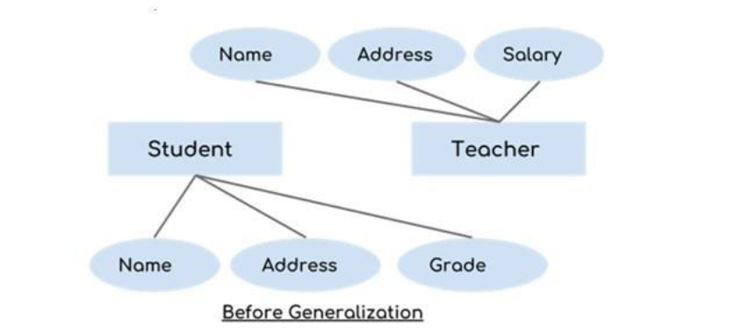
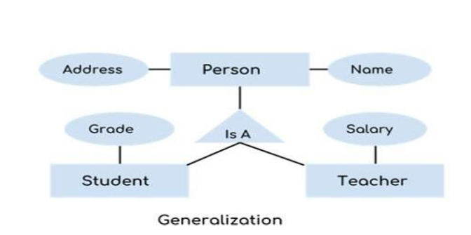

Slide 79
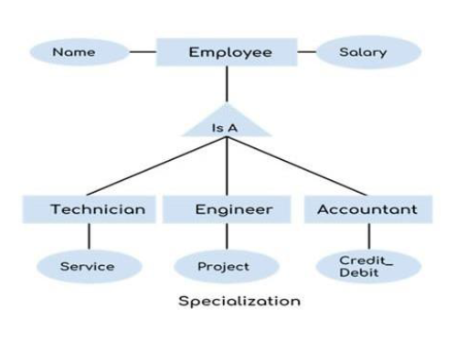

Slide 80
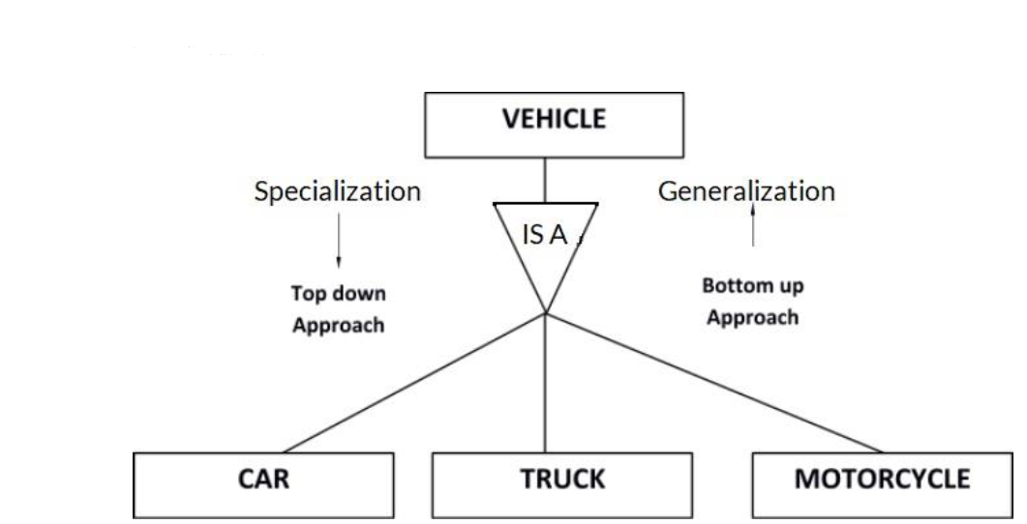

Slide 83
set-3
part 2
1 Illustrate the role of a primary key in a relation.
2 Illustrate the cardinality and degree of a relation.
3 Classify different types of constraints used in relational schema.
1 A Construct ER diagrams to represent specialization and
generalization.
B Apply various constraints over Relational model with examples.
A Examine participation constraints used in ER-model.
B Classify the different components used in ER model.
3 A Analyze Subclasses, Super classes, and Inheritance in DBMS.
B Investigate the Integrity constraints in DBMS with examples.

Slide 84
UNTIT-III
PART_1 SQL:
Simple Database schema
Data types
Table definitions (create, alter)
Different DML operations (insert, delete, update).
Relational Algebra, Relational Calculus
Basic SQL querying (select and project) using where clause
Arithmetic & logical operations
SQL functions (Date and Time, Numeric, String conversion).

Slide 85
PART_2
Creating tables with relationship
Implementation of key and integrity constraints
Nested queries, sub queries
Grouping, aggregation, ordering
Implementation of different types of joins
View (updatable and non-updatable)
Relational set operations.

Slide 86
1.Simple Database Schema
Description about database or relation
Database schema describes the structure of a database. It specifies :
What tables are present
What columns each table contains
What data type each column has
Which column is the primary key
How tables are related
SID → identifies a student
CID → identifies a course
(SID, CID) → composite primary key
Foreign keys establish relationships between tables.
Example: Student Database
STUDENT (SID,SNAME,AGE,DEPT);
COURSE(CID,CNAME,CREDITS);
ENROLLMENT(SID,CID,MARKS );

Slide 87
2. Data Types
A data type specifies what kind of value can be stored in a column.
Data Type | Purpose | Example
NUMBER | Numbers | 100, 25.5
VARCHAR2 | Variable-length text | 'Naresh'
CHAR | Fixed-length text | 'M'
DATE | Date and time | 18-AUG-2024
TIMESTAMP | Date and time with more precision | 18-AUG-2024 10:30:20
CLOB | Large text | Long documents
BLOB | Binary data | Images/files

Slide 88
Data types:
char
char
varchar
number
int -2,147,483,648 and 2,147,483,647
decimal(p, s) decimal(12,4)
float(p)
Date and Time
date yyyy-mm-dd
time hh:mm:ss
timestamp yyyy-mm-dd hh:mm:ss

Slide 89
3.Table definitions (create, alter)
Create: used to create table
Alter: used to change schema
Add a column
Modify a column
Rename a column
Drop a column

Slide 90
4. Different DML operations (insert, delete, update)
DML commands are used to manipulate the data stored inside tables.
insert : Used to add new records.
delete : Used to remove existing records.
update : Used to modify records.

Slide 91
5. Relational Algebra
Relational Algebra is a procedural query language used to retrieve information from relational databases.
It tells us what operation should be performed on a relation.
Operator | Name | Use
σ | Selection | Select rows
π | Projection | Select columns
∪ | Union | Combine relations
− | Set Difference | Difference between relations
× | Cartesian Product | Combine every row
⋈ | Join | Combine related tables

Slide 92
Selection – σ : Selection retrieves rows satisfying a condition.
Ex: STUDENT(SID, SNAME, AGE, DEPT)
find students whose age is greater than 20:
σ AGE > 20 (STUDENT)
Projection – π : Projection retrieves columns.
To display only student names: π SNAME (STUDENT)
find the names and departments of students whose age is greater than 20
σ AGE > 20 (STUDENT)
π SNAME, DEPT ( σ AGE > 20 (STUDENT) )

Slide 93
SID | Name | Age | Dept
101 | Ravi | 20 | CSE
102 | Siva | 22 | ECE
103 | Kumar | 21 | CSE
104 | Anu | 23 | EEE
105 | Ram | 21 | CIVIL
106 | Abhi | 22 | ECE
107 | Sita | 21 | CSE
108 | Teja | 22 | CIVIL
109 | Siva | 23 | EEE
110 | Pqr | 22 | MECH
Select CSE students
Select students whose age is greater than 21
Display only student names
Display Name and Department

Slide 94
6.Relational Calculus
Relational Calculus is a non-procedural query language used in DBMS.
It tells us what data is required, but not how to retrieve the data.
Find students whose age is greater than 20.
In Relational Calculus, we specify the condition:
SID | Name | Age | Dept
101 | Ravi | 20 | CSE
102 | Siva | 22 | ECE
103 | Kumar | 21 | CSE
104 | Anu | 23 | ECE
105 | Ram | 21 | CIVIL
106 | Abhi | 22 | ECE
107 | Sita | 21 | CSE
108 | Teja | 22 | CIVIL
109 | Siva | 23 | EEE
110 | Pqr | 22 | MECH
Tuple Relational Calculus (TRC)
Domain Relational Calculus (DRC)

Slide 95
Tuple Relational Calculus (TRC)
TRC uses a tuple variable to represent a complete row of a relation.
General form: { t | P(t) } t → tuple variable P(t) → condition/predicate
Example: { t | t ∈ STUDENT AND t.AGE > 20 }
Domain Relational Calculus (DRC)
DRC uses domain variables, which represent individual column values.
General form: { <x1, x2, ..., xn> | P(x1, x2, ..., xn) }
To find the names of students whose age is greater than 20:

Slide 96
{ <name> | ∃ sid, age, dept
(STUDENT(sid, name, age, dept) AND age > 20)
}
<name> → What do we want? → NAME
∃ → There exists
sid, age, dept → Other column values
STUDENT(...) → Take values from STUDENT
AND age > 20 → Apply condition

Slide 97
Find all students
Find students whose age is greater than 20
Find CSE students
Find the student whose SID is 102
Find students whose age is between 20 and 22
{ t | t ∈ STUDENT }
{ t | t ∈ STUDENT AND t.AGE > 20 }
{ t | t ∈ STUDENT AND t.DEPT = 'CSE' }
{ t | t ∈ STUDENT AND t.SID = 102 }
{ t | t ∈ STUDENT AND t.AGE >= 20 AND t.AGE <= 22 }

Slide 98
Find all student names
Find names of students whose age is greater than 20
Find names of CSE students
Find names and ages of students
Find names of CSE students whose age is greater than 19
1.{ <name> | ∃ sid, age, dept
(STUDENT(sid, name, age, dept)) }
2.{ <name> | ∃ sid, age, dept
(STUDENT(sid, name, age, dept) AND age > 20) }
3. { <name> | ∃ sid, age, dept
(STUDENT(sid, name, age, dept) AND dept=‘cse’) }
4. { <name,age> | ∃ sid, dept
(STUDENT(sid, name, age, dept)) }
5.{ <name> | ∃ sid, age, dept
(STUDENT(sid, name, age, dept)
AND dept = 'CSE’ AND age > 19) }

Slide 99
Consider Schema: EMP(EID, ENAME, ADDRESS, SALARY, PHNO, EXP)
Write the Tuple Relational Calculus (TRC) expressions for:
Find all employees.
Find employees whose salary is greater than 50000.
Find employees whose experience is greater than 5 years.
Find employees who live in Hyderabad.
Find employees whose salary is equal to 60000.
Find the employee whose EID is 103.
Find employees whose experience is less than 5 years.
Find employees whose salary is greater than 40000 and experience is greater than 3yrs.
Find employees who live in Hyderabad and have a salary greater than 50000.
Find employees whose salary is between 40000 and 60000.

Slide 100
Write the Domain Relational Calculus (DRC) expressions for:
→ Find the names of all employees.
→ Find the names of employees whose salary is greater than 50000.
→ Find the names of employees whose experience is greater than 5 years.
→ Find the names of employees who live in Hyderabad.
→ Find the names of employees whose salary is equal to 60000.
→ Find the name of the employee whose EID is 103.
→ Find the names of employees whose experience is less than 5 years.
Find the names of employees whose salary is greater than 40000 and
experience is greater than 3 years.
Find the names of employees who live in Hyderabad and have a salary
greater than 50000.
Find the names and salaries of employees whose salary is between 40000
and 60000.

Slide 101
Relational Algebra | Relational Calculus
Procedural | Non-procedural
Specifies how to retrieve data | Specifies what data is required
Uses operators | Uses predicates and logical expressions
Selection, Projection, Join | TRC and DRC
Example: σ AGE > 20(STUDENT) | {t | t ∈ STUDENT AND t.AGE > 20}

Slide 102
7. Basic SQL querying (select and project) using where clause
SELECT is used to retrieve data from a table.
Display all columns : SELECT * FROM STUDENT;
Display selected columns: SELECT SID, SNAME FROM STUDENT;
WHERE Clause: it is used to specify a condition.
SELECT * FROM STUDENT WHERE DEPT= 'CSE';

Slide 103
8.Arithmetic & logical operations
Arithmetic operators : Perform mathematical calculations.
Operator | Operation
+ | Addition
- | Subtraction
* | Multiplication
/ | Division
Logical operations: Combine conditions.
AND : Both conditions must be true. OR : Any one condition must be true.
NOT : Reverses the condition.

Slide 104
9. Comparison Operators
Operator | Name
= | Equal
> | Greater than
< | Less than
>= | Greater than or equal
<= | Less than or equal
<> | Not equal

Slide 105
10.SQL Functions
SQL provides built-in functions for performing operations on data.
SQL Functions are classified into :
Date and Time Functions
Numeric Functions
String Functions
Conversion Functions

Slide 106
Date and Time Functions:: Handle with date and time
SYSDATE : Returns the current system date and time.
CURRENT_DATE : Returns the current date based on the session time zone.
ADD_MONTHS : Adds months to a date
MONTHS_BETWEEN : number of months between two dates.

Slide 107
Numeric Functions :
ROUND :Rounds a number
CEIL :Returns the smallest integer greater than or equal to the number.
FLOOR : Returns the largest integer less than or equal to the number
MOD : Returns the remainder
ABS : Returns the absolute value
SQRT POWER

Slide 108
String Functions
String functions operate on text.
UPPER : SELECT UPPER(‘S‘) FROM DUAL;
LOWER : SELECT ULOWER(‘S‘) FROM DUAL;
LENGTH : SELECT LENGTH(‘S') FROM DUAL;
SUBSTR : SELECT SUBSTR(‘S', SP, len)FROM DUAL;
CONCAT: SELECT CONCAT(‘S1', ‘S2‘) FROM DUAL;
INITCAP :
PAD :
TRIM :
INSTR :

Slide 109
Conversion Functions

Slide 114
Table definitions (create, alter)
Different DML operations (insert, delete, update).
Basic SQL querying (select and project) using where clause
Arithmetic & logical operations
Relational set operations.
SQL functions (Date and Time, Numeric, String conversion).

Slide 115
Relational set operations
UNION
The SQL Union operation is used to combine the result of two or more SQL SELECT queries.
The union operation eliminates the duplicate rows from its resultset.
UNION ALL
Union All operation is equal to the Union operation. It returns the set without removing duplication
INTERSECT
It is used to combine two SELECT statements. The Intersect operation returns the common rows from both the SELECT statements.
Minus
It combines the result of two SELECT statements. Minus operator is used to display the rows which are present in the first query but absent in the second query.

Slide 116
Operator | Description
ALL | Used to compare a specific value to all other values in a set
ANY | Compares a specific value to any of the values present in a set.
IN | Used to compare a specific value to the literal values mentioned.
BETWEEN | Searches for values within the range mentioned.
AND | Allows the user to mention multiple conditions in a WHERE clause.
OR | Combines multiple conditions in a WHERE clause.
NOT | A negate operators, used to reverse the output of the logical operator.
EXISTS | Used to search for the row’s presence in the table.
LIKE | Compares a pattern using wildcard operators.
SOME | Similar to the ANY operator, and is used compares a specific value to some of the values present in a set.

Slide 117
JOINS
Inner joins outer joins
Theta natural left right full
Select list from table1
Join
table2 on Condition

Slide 118
Unit-IV Schema Refinement (Normalization):
→Purpose of Normalization or schema refinement
→concept of functional dependency
→normal forms based on functional dependency
→Lossless join and dependency preserving decomposition
→(1NF, 2NF and 3 NF)
→concept of surrogate key
→Boyce-Codd normal form(BCNF)
→Fourth normal form(4NF)
→Fifth Normal Form(5NF).

Slide 119
Purpose of Normalization
Normalization enhances databases by: →reducing redundancy
→minimizing anomalies
→improving integrity
→optimizing storage, and
→simplifying maintenance.
Anomalies: Anomalies refers to the problems occurred after poorly planned and normalised databases where all the data is stored in one table which is sometimes called a flat file database

Slide 120
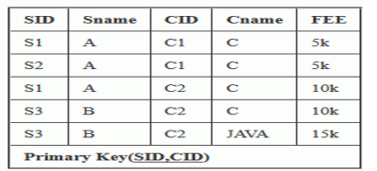
Due to redundancy of data we may get the following problems:
insertion anomalies : It may not be possible to store some information unless some other information is stored as well.
update anomalies: If one copy of redundant data is updated, then inconsistency is created unless all redundant copies of data are updated.
3. deletion anomalies: It may not be possible to delete some information without losing some other information as well.

Slide 121
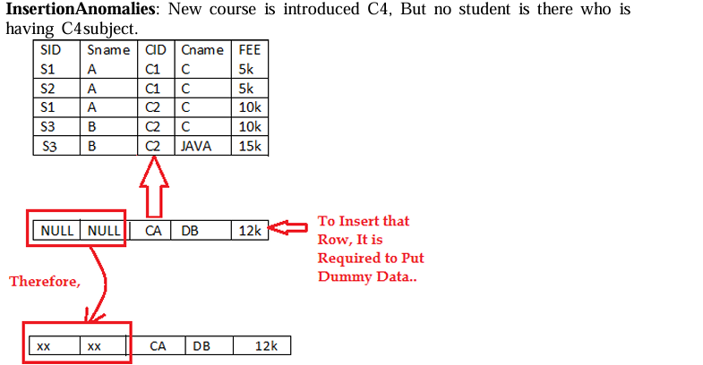

Slide 122
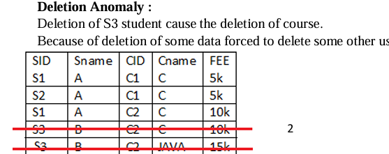

Slide 123
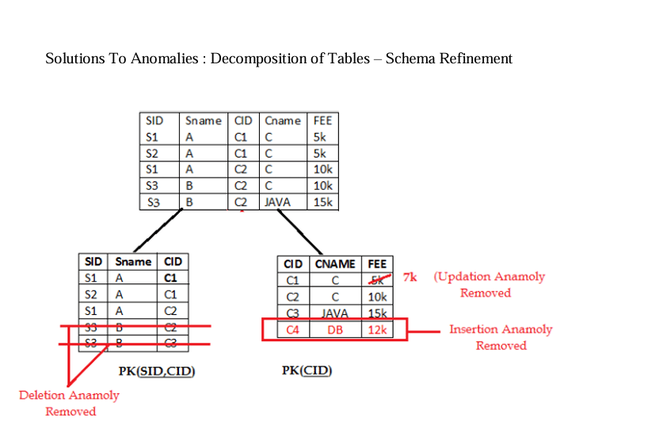

Slide 124
Concept of functional dependency:
In A relationship where one/mpre attribute/s uniquely determines another. →
EX: STUDENT(htno, Name, Age, add) htno -> Name
A functional dependency A-->B in a relation holds true if two tuples having the same value of attribute A also have the same value of attribute B
IF t1.X=t2.X then t1.Y=t2.Y where t1,t2 are tuples and X,Y are attributes.

Slide 125
Types of functional dependencies:
→Trivial Functional Dependency
→Non-Trivial Functional Dependency
→Multivalued Functional Dependency
→Transitive Functional Dependency
→Fully Functional Dependency
→Partial Functional Dependency

Slide 126
Trivial functional dependency:-If X-->Y is a functional dependency where Y is subset of X, these type of FD’s called as trivial functional dependency.
Non-trivial functional dependency:-If X-->Y and Y is not subset of X then it is called non-trivial functional dependency.
Transitive dependency – If A->B and B->C are two FDs then A->C is called transitive dependency.
MVD or multivalued dependency means that for a single value of attribute ‘a’ multiple values of attribute ‘b’ exist. We write it as,
a --> --> b

Slide 127
Normal forms based on Functional dependency:
Normalisation removes data redundancy and it will helps in designing a good data base which involves a set of normal forms as follows –
1)First normal form(1NF)
2)Second normal form(2NF)
3)Third normal form(3NF)
4)Boyce coded normal form(BCNF)
5)Forth normal form(4NF)
6)Fifth normal form(5NF)
7)Sixth normal form(6NF)
8)Domain key normal form.

Slide 128
Keys in dbms:
Super Key
Candidate key
Primary Key
Alternate Key
Foreign Key
Composite Key
Compound Key
surrogate key

Slide 129
Super Key: A super key is a set of one or more keys that are used to identify data or records uniquely in a database table.
Candidate key: Minimal sub set of a super key not a super key
Primary Key: It is a candidate key
Alternate Key : among candidate keys one of the key is PK remaining CKs are AKS (except PK)
Foreign Key: maintain integrity example
Composite Key: it is key with combination of attribute
Compound Key: except Composite keys
surrogate key: adding key

Slide 130
Rules for FDS: Armstrong axiom rules 7
Primary:
1.Reflexivity A→A A→B B is subset of A Trivial
2. Transitivity if A→B B→C then A→C transitive FD
3.Augumentation if A→B then AX→BX
Secondary:
Union A→B and A→C then A→BC
Splitting or Decomposition A→BC then A→B A→C
Pseudo Transitivity if X→Y and YZ→A then XZ→A
Composition X→Y and A→B then XA→YB

Slide 131
1)First normal form(1NF)
If a relation in 1NF it Follows:
It have all single valued attributes
Values under col should be same domain
All cols have unique names
The order of storing does not mater
Each record should be unique
Example:
sid | sname | address | cname
1 | Ram | A1 | C,CPP
2 | Sai | A1 | JAVA
3 | Abhi | A2 | SQL,PP

Slide 132
sid | sname | address | cname1 | cname2 | cname3
1 | Ram | A1 | C | CPP | SQL
2 | Sai | A1 | NULL | NULL | JAVA
3 | Abhi | A2 | NULL | PP | SQL
Method 1
sid | sname | address | cname1
1 | Ram | A1 | C
1 | Ram | A1 | CPP
1 | Ram | A1 | SQL
2 | Sai | A1 | JAVA
3 | Abhi | A2 | SQL
3 | Abhi | A2 | PP
Method 2

Slide 133
sid | cname
1 | C
1 | CPP
1 | SQL
2 | JAVA
3 | SQL
3 | PP
Method 3
sid | sname | address
1 | Ram | A1
2 | Sai | A1
3 | Abhi | A2

Slide 134
2)Second normal form(2NF)
If Relation in 2NF it follows
It is in 1Nf
It not having PD
Htno | Sname | Add | Phno | Cname | Fee | DOJ
1 | abc | a1 | 123 | C | 5K | 13-10-23
1 | abc | a1 | 123 | CPP | 8K | 12-11-24
2 | xyz | a2 | 456 | sql | 10K | 14-02-24
3 | pqr | a1 | 568 | sql | 10K | 13-12-24
3 | pqr | a1 | 568 | java | 7K | 13-10-23
Htno | Sname | Add | Phno
1 | abc | a1 | 123
2 | xyz | a2 | 456
3 | pqr | a1 | 568
Cname | Fee
C | 5K
CPP | 8K
sql | 10K
java | 7K
Htno | Cname | DOJ
1 | C | 13-10-23
1 | CPP | 12-11-24
2 | sql | 14-02-24
3 | sql | 13-12-24
3 | java | 13-10-23

Slide 135
3)Third normal form(3NF)
If Relation in 2NF it follows
It is in 2Nf
It not having TD
eid | ename | add | sal | phno | comp | loc
1 | abc | a1 | 40k | 123 | c1 | Hyd
2 | xyz | a3 | 25k | 234 | c1 | Hyd
3 | pqr | a1 | 35k | 456 | c2 | Vja
4 | abc | a2 | 50k | 567 | c3 | Vja
Eid→comp
com→loc
Eid→loc TD
eid | ename | add | sal | phno | comp
1 | abc | a1 | 40k | 123 | c1
2 | xyz | a3 | 25k | 234 | c1
3 | pqr | a1 | 35k | 456 | c2
4 | abc | a2 | 50k | 567 | c3
comp | loc
c1 | Hyd
c2 | Vja
c3 | Vja

Slide 136
4)Boyce coded normal form(BCNF)
If Relation in BCNF it follows
It is in 3Nf
If there is a FD like A→B A must be a SK
sid | sname | cname | faculty
1 | Abc | C | S
1 | Abc | CPP | T
2 | Xyz | C | S
3 | Pqr | C | M
3 | Pqr | SQL | N
sid | faculty
1 | S
1 | T
2 | S
3 | M
3 | N
faculty | cname
S | C
T | CPP
M | C
N | SQL
sid | sname
1 | Abc
2 | Xyz
3 | Pqr

Slide 137
5)Forth normal form(4NF)
MVD: A→B Single value of a and Multiple values of B
If Relation in 4NF it follows
It is in BCNf
No MVD
sid | sname | add | phno | cname | hobby
1 | Abc | A1 | 234 | c | music
1 | Abc | A1 | 234 | cpp | cricket
2 | Xyz | A2 | 345 | java | cricket
2 | Xyz | A2 | 345 | sql | hockey
sid | sname | add | phno
1 | Abc | A1 | 234
2 | Xyz | A2 | 345
sid | cname
1 | c
1 | cpp
2 | java
2 | sql
sid | hobby
1 | music
1 | cricket
2 | cricket
2 | hockey

Slide 138
6)Fifth normal form(5NF)

Slide 139
Rules for FDS: Armstrong axiom rules 7
Primary:
1.Reflexivity A→A A→B B is subset of A Trivial
2. Transitivity if A→B B→C then A→C transitive FD
3.Augumentation if A→B then AX→BX
Secondary:
Union A→B and A→C then A→BC
Splitting or Decomposition A→BC then A→B A→C
Pseudo Transitivity if X→Y and YZ→A then XZ→A
Composition X→Y and A→B then XA→YB

Slide 140
Attribute Closure: A is a attribute or set attributes
Closure of A is A+ it contains set attributes determined by A.
Example:
R(A,B,C,D,E) and FDS { A→B B→C C→D D→E} find Candidate keys
SK: It is a attribute or set of attributes whose closure having all attributes
CK: Proper Subset of SK is Not a SK

Slide 141
PART-I
Transaction Concept:
Transaction State, ACID properties,
Concurrent Executions in conflict resolution,
Serializability, Recoverability, Implementation of Isolation,
Testing for Serializability, lock based, time stamp based, optimistic, concurrency protocols,
Deadlocks, Failure Classification, Storage, Recovery and Atomicity, Recovery algorithm.
PART-II
Introduction to indexing:
B+ trees, B+ trees operations.
UNIT-V

Slide 142
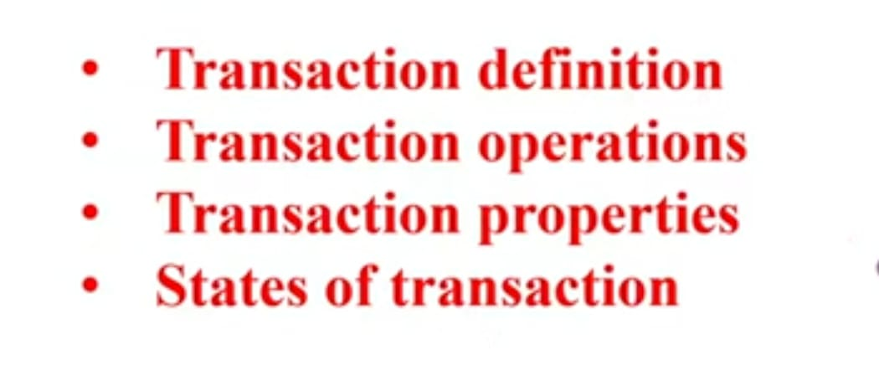

Slide 143
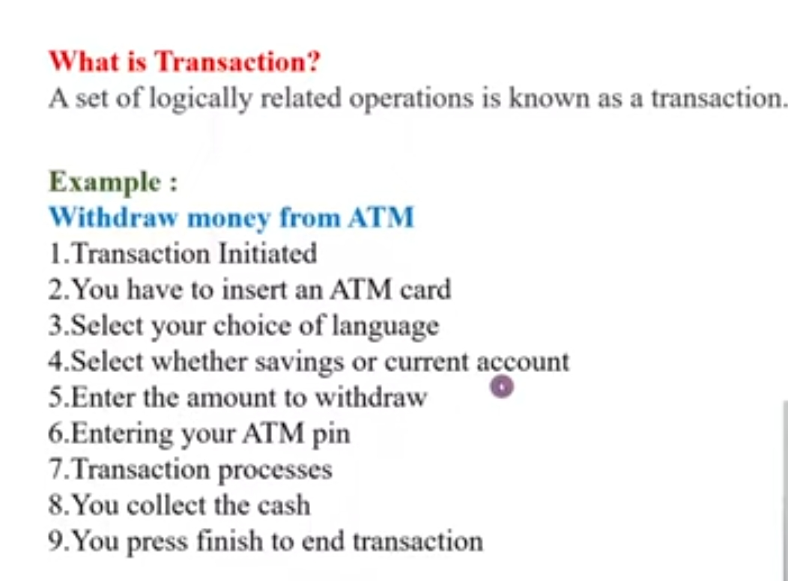

Slide 144


Slide 145


